Slide 1


Introduction to Generative AI
Ilia German

Slide 2

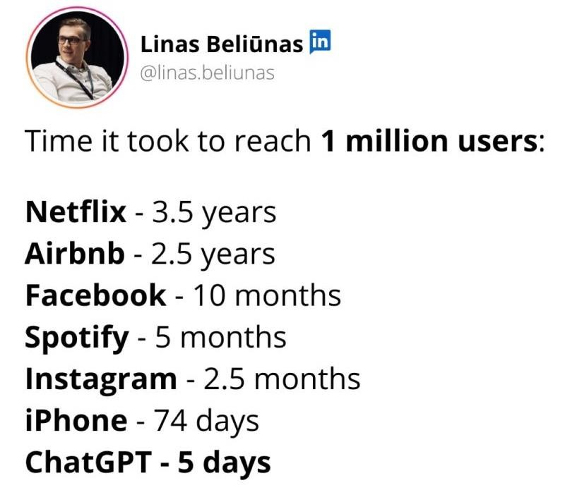










Generative AI is the fastest growing trend in AI
Consumer adoption
ChatGPT reached the 1 million users mark in just 5 days
ChatGPT
5 days
Instagram
75 days
Spotify
150 days
1M
500k
Stylized path
0 | 25 | 50 | 75 | 100 | 125 | 150
Days since launch
2

Slide 3



93%
3
of companies believe AI will be a game changer in driving growth and innovation in the sector
© 2024, Amazon Web Services, Inc. or its affiliates. All rights reserved. ₃
3

Slide 4



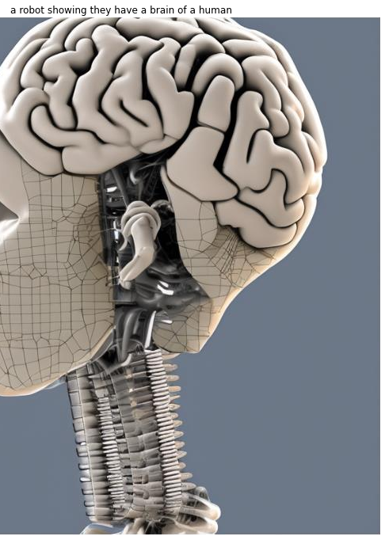
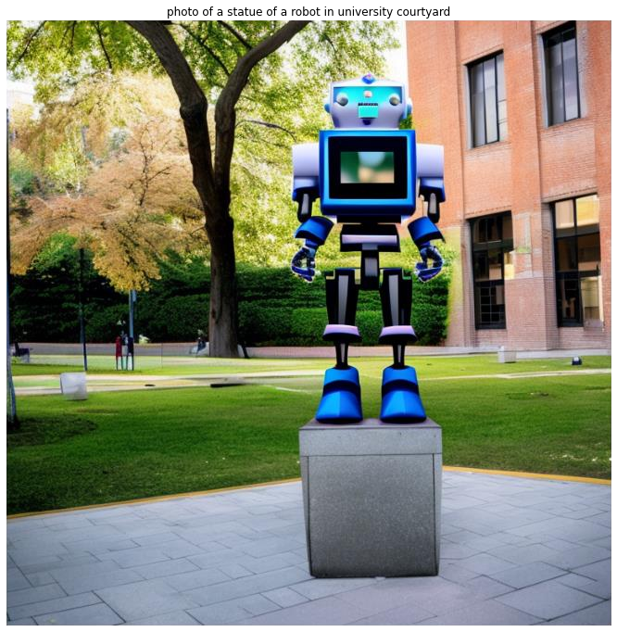






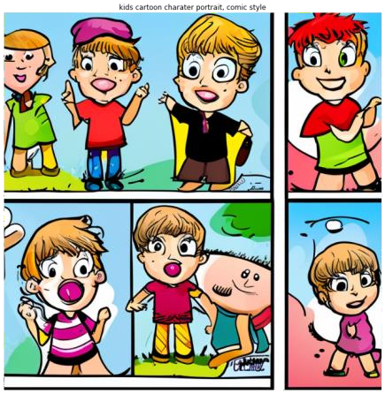



Slide 5
Question: What is generative AI?
Creates new content and ideas, including conversations, stories, images, videos, and music
Powered by large models that are pretrained on vast corpora of data and commonly referred to as foundation models (FMs)

Slide 6
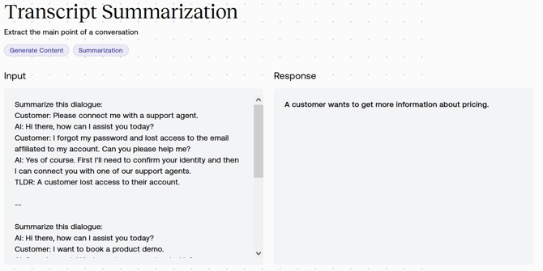
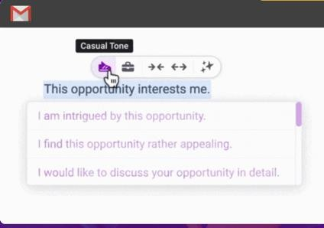




So what is Generative AI?
Generative AI is a set of algorithms, capable of generating seemingly original, realistic content—such as
text, images, audio, or video —from vast amounts of training data.
OpenAI ChatGPT is a well-known example, but this is an emerging field with a large ecosystem of generative AI providers. Pre-trained models from these providers can be deployed privately in your AWS account for enterprise use cases such as:
TEXT SUMMARIZATION TEXT GENERATION TEXT-TO-IMAGE

Slide 7




















How foundation models differ from other ML models
Tasks
Tasks
Labeled data
ML model
Text generation
Text generation
Labeled data
ML model
Summarization
Summarization
Labeled data
Labeled data
ML model
Information extraction
Unlabeled data
Foundation
model
Information extraction
ML model
Q&A
Q&A
Labeled data
ML model
Chatbot
Chatbot
Train
Deploy
Pre-train
Adapt

Slide 8







Generative AI Challenges
Customers need to responsibly innovate and implement generative AI
1
2
3
4
Quality
Gen AI model unable to answer questions coherently or summarize text risking user confidence
Toxicity
Gen AI model outputs may create harmful images or videos risking company reputation
Bias
Gen AI model outputs can be inherently biased based on the training data set impacting different subpopulations
Hallucinations Gen AI models can generate outputs that sound plausible but are factually inaccurate

Slide 9


Generative AI Challenges
Customers need to responsibly innovate and implement generative AI
5
Cost!!
Inferencing Gen AI LL Models is very costly!

Slide 10






Your data is the differentiator
Generic
generative AI
Generative AI that knows your business and your customers

Slide 11






A more personal virtual agent
An online travel agency wants to generate
personalized travel itineraries
The data
Past trips
Flight and hotel inventory
Web history
Promotions
Travel preferences
Similar traveler details

Slide 12




Common approaches for customizing FMs
Complexity, Quality, Cost,
Time
Continued Pre- Training (CPT)
Fine Tuning (FT)
Retrieval Augmented Generation (RAG)
Prompt Engineering

Slide 13
Prompt Engineering – Introduction
What is a Prompt?
Text input provided to an AI system to elicit a response
What is Prompt Engineering?
Using NLP techniques to craft prompts that steer FMs/LLMs towards desired responses
Why is this important?
Enables fine-grained and strategic control over models’ behavior
Targets desired capabilities
Mitigates risks
Prompt
Response
Input
FM
Output
*NLP = Natural Language Processing FM = Foundation Model
LLM = Large Language Model

Slide 14
How to talk to a large language model?
Few-shot prompting
Complete the task based on a set of examples (aka in- context learning)
Zero-shot prompting
Complete the task based on the instruction given (zero examples)

Slide 15

Prompt engineering - Few-shot
Label the following sentence by sentiment: Frankly, my dear, I don't give a damn Labels: Indifferent, Apathetic, Neutral
##
Label the following sentence by sentiment: I'm gonna make him an offer he can't refuse Labels: Threatening, Scheming
##
Label the following sentence by sentiment: think before you act
Labels: Cautionary, Adviseful
1
2
3

Slide 16
Prompt engineering – Zero-shot
Label the following sentence by sentiment: think before you act
Labels: Positive
2nd Try:
Label the following sentence by sentiment with two Descriptive Adjectives:
think before you act
Descriptive Adjectives: cautious, thoughtful

Slide 17
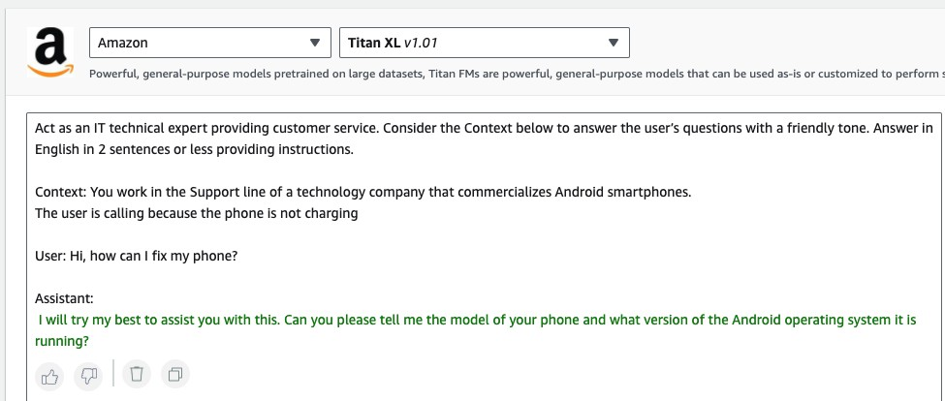
(Typical) Prompt Structure
Instructions
Context
User Input
Output Indicator

Slide 18
Your data is the differentiator
Generic
generative AI
Generative AI that knows your business and your customers

Slide 19









RAG in Action
User Input
Text Generation Workflow
User
Prompt
augmentation
Large Language
Model
Response
Embeddings model
Context
Embedding
0.89 -0.02 -0.53 0.95 0.17
-0.38
Data Ingestion Workflow
Semantic search
Vector store
Embeddings model
Document chunks
Data source

Slide 20



Customizing LLMs
PURPOSE
D A T A
N E E D
P U R P O S E
D A T A
N E E D
Maximizing accuracy
for specific tasks
Small number
of labeled examples
Maintaining model accuracy for your domain
Large number
of unlabeled datasets

Slide 21








CHATBOTS
CONVERSATIONAL SEARCH
DOCUMENT PROCESSING
VIRTUAL ASSISTANTS
SUMMARIZATION
DATA AUGMENTATION
CONVERSATION ANALYTICS
CONTENT CREATION
CYBERSECURITY
PERSONALIZATION
CODE GENERATION
PROCESS OPTIMIZATION
DATA TO INSIGHTS
© 2024, Amazon Web Services, Inc. or its affiliates.
23

Slide 22
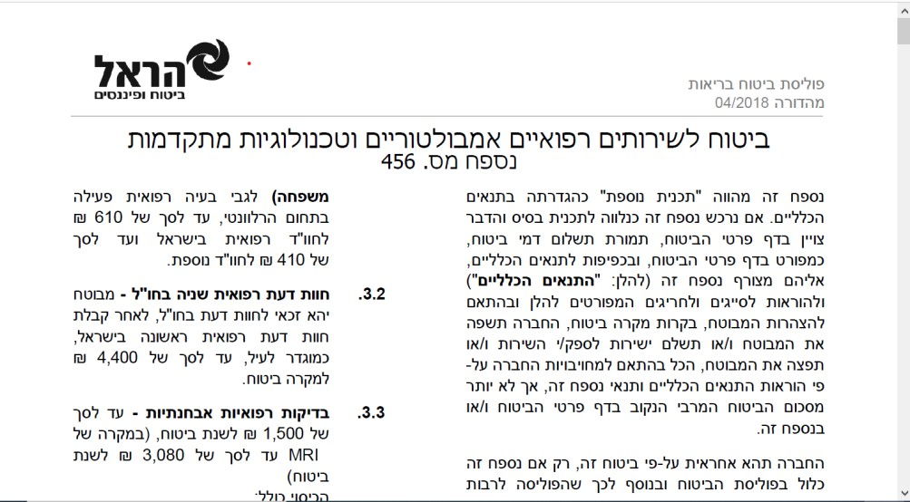
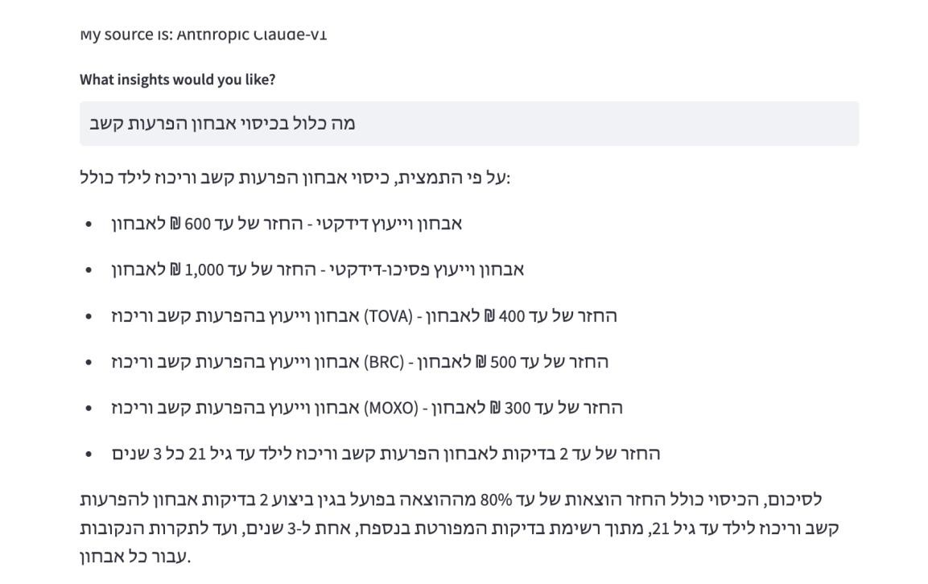
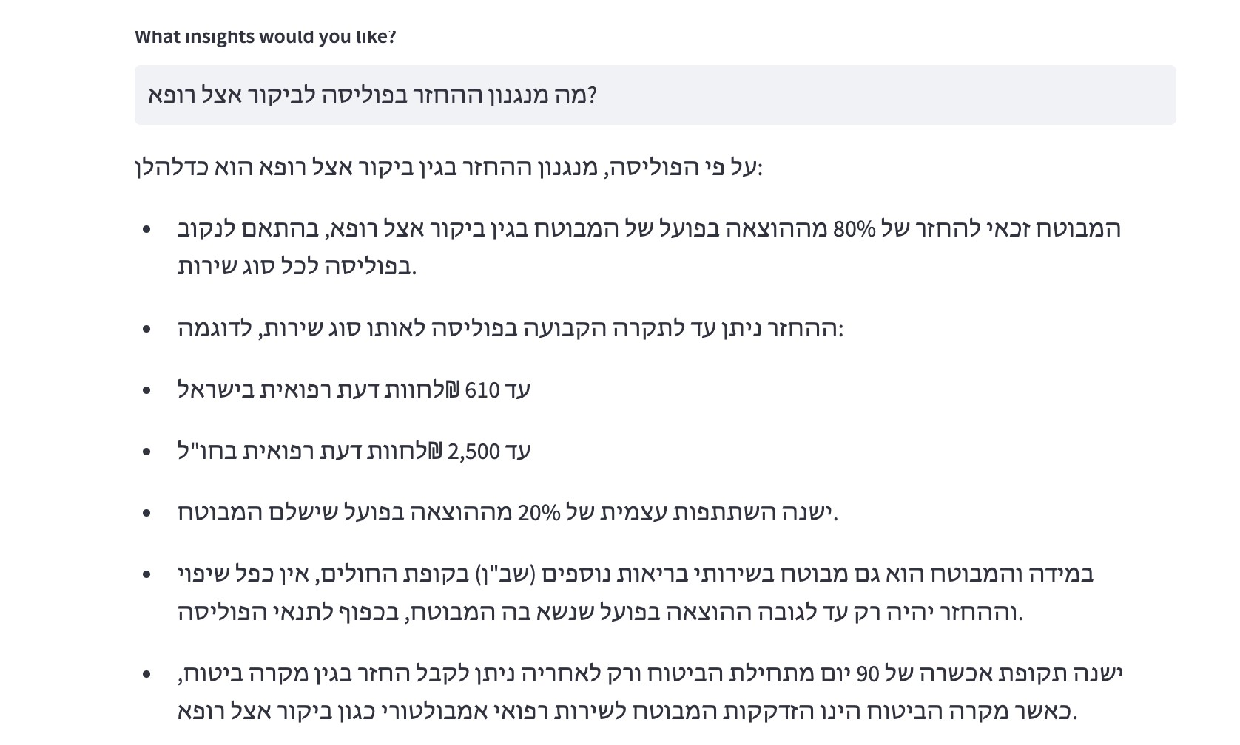
Demos
30

Slide 23










Generative AI Stack
Amazon Q
Business
Amazon Q Developer
Amazon Q in QuickSight
Amazon Q in
Connect
Amazon Bedrock
Agents Customization Capabilities
Guardrails
GPUs
Trainium
Inferentia
SageMaker
UltraClusters
EFA
EC2 Capacity Blocks Nitro
Neuron
34

Slide 24








Generative AI Stack
SageMaker
Trainium
Inferentia
GPUs
UltraClusters
EFA
EC2 Capacity Blocks
Nitro
Neuron

Slide 25

Access the latest and publicly available FMs
Build FMs from scratch
Amazon
Customize FMs
Build, train, and deploy ML models at scale, including FMs
Run inference
Implement FMOps and governance

Slide 26



Innovating at the silicon level
AWS
AWS
37

Slide 27







Generative AI Stack
Amazon Bedrock
Guardrails Agents
Studio
Customization
Custom Model Import
Amazon Models

Slide 28




Amazon Bedrock simplifies
Customization
Integration
Responsible AI

Slide 29






Amazon Bedrock
B R O A D C H O I C E O F M O D E L S
Contextual answers, | Text summarization, | Summarization, | Text generation, | Q&A and reading | Text summarization, | High-quality
summarization, | generation, Q&A, | complex reasoning, | search, | comprehension | text classification, | images and art
paraphrasing | search, image | writing, coding | classification |  | text completion,
generation
code generation, Q&A
Mistral Large 2 (24.07)
Mistral Large (24.02) Mistral Small Mixtral 8x7B
Mistral 7B
Jamba 1.5 Large
Jamba 1.5 Mini Jamba-Instruct Jurassic-2 Ultra Jurassic-2 Mid
Amazon Titan Text Premier
Amazon Titan Text Lite
Amazon Titan Text Express
Amazon Titan Text Embeddings
Amazon Titan Text
Embeddings V2
Amazon Titan Multimodal Embeddings
Amazon Titan Image Generator
Upgraded Claude 3.5 Sonnet
Claude 3.5 Sonnet
Claude 3 Opus
Claude 3 Sonnet
Claude 3 Haiku
Claude 2.1
Claude 2 Claude Instant
Command Command Light Embed English Embed Multilingual Command R+ Command R
Llama 3.2
Llama 3.1
Llama 3 8B
Llama 3 70B
Llama 2 13B
Llama 2 70B
Stable Image Ultra Stable Diffusion 3
Large
Stable Image Core Stable Diffusion XL1.0 Stable Diffusion
XL 0.8
© 2024, Amazon Web Services, Inc. or its affiliates. All rights reserved.

Slide 30

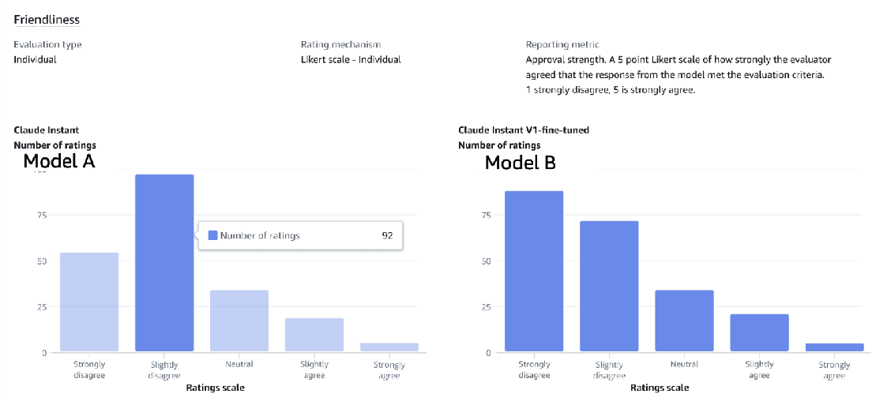

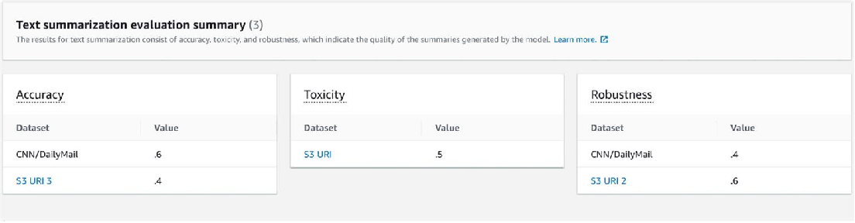
Amazon Bedrock Model Evaluation
H U M A N
E V A L U A T I O N
R E P O R T
E V A L U A T E , C O M P A R E , A N D S E L E C T T H E B E S T F M F O R Y O U R U S E C A S E
Automatic or human evaluation method
Curated datasets or bring your own Predefined and custom metrics
A U T O M A T I C
E V A L U A T I O N
R E P O R T

Slide 31

Amazon Bedrock simplifies
Choice
Integration
Responsible AI

Slide 32

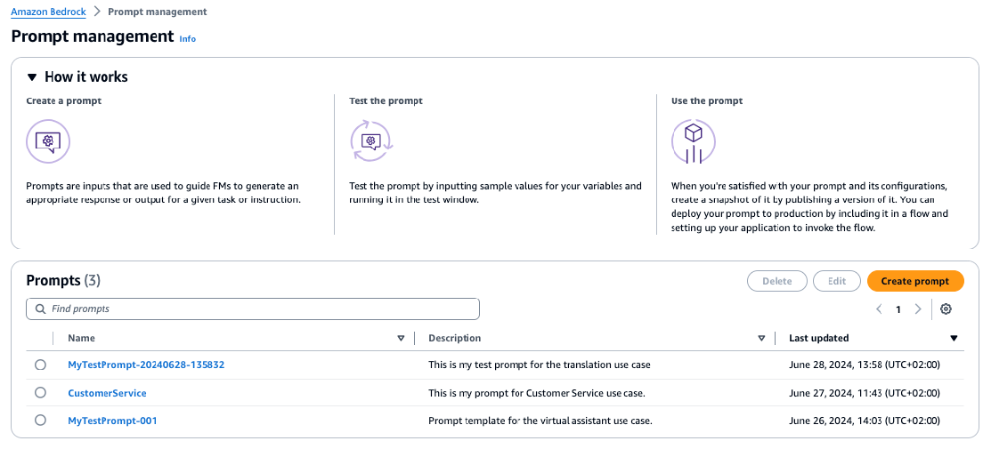

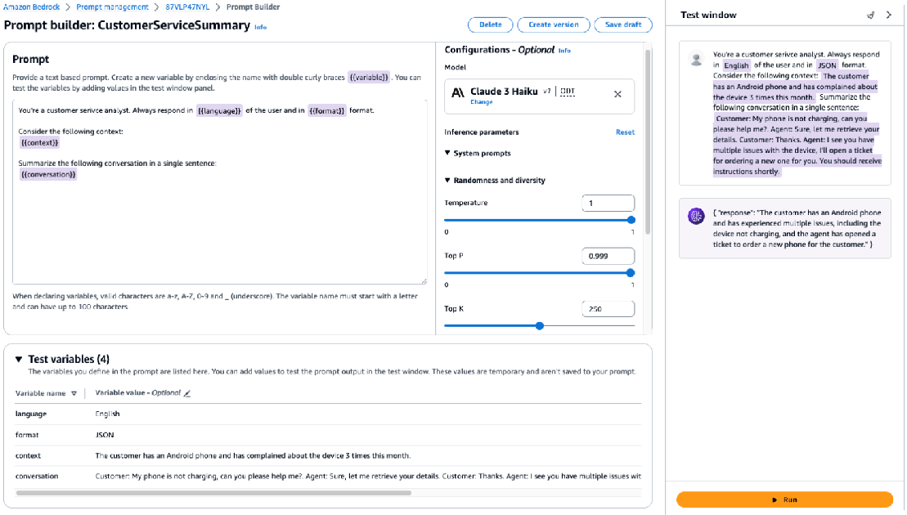
Amazon Bedrock Prompt Management
S T R E A M L I N E Y O U R G E N E R A T I V E A I A P P L I C A T I O N S D E V E L O P M E N T
Built-in Prompt Builder in Amazon Bedrock
console and SDK APIs
Prompt Library for easy cataloguing and management
Seamless integration with Flows and Bedrock Studio

Slide 33




None of the customer’s data is used to train the underlying models, nor is it shared with Model Providers
All data is encrypted in transit and at rest; data used for customization is securely transferred through customer’s VPC
Data remains in the region where API
processed
Support for GDPR, SOC, ISO, CSA compliance and HIPAA eligibility
Helps keep your data secure and private

Slide 34








Apply guardrails to multiple foundation models and Agents for Amazon Bedrock
Configure harmful content filtering based on
your responsible AI policies
Guardrails for Amazon Bedrock
Implement application specific safeguards based on your use cases and responsible AI policies
Define and disallow denied topics with short natural language descriptions
Redact sensitive PII information in FM
responses

Slide 35







How it works
FM Inference
Guardrail
Responsible AI Policies
Denied Topics
Content Filters
PII Redaction
Word Filter

Slide 36
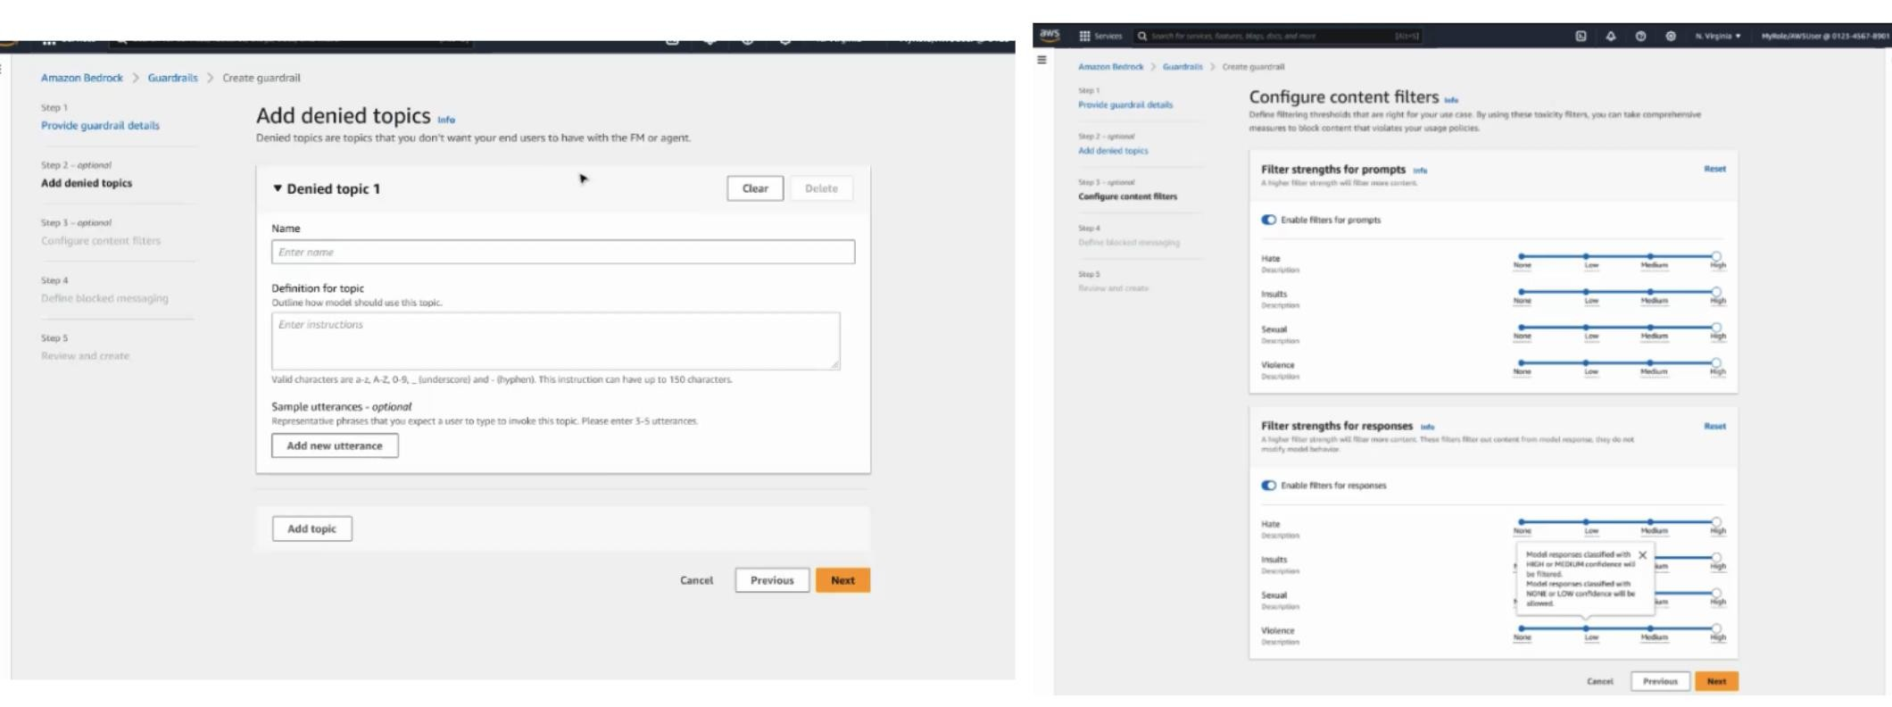


Guardrails
1
2

Slide 37


The most successful pilots focus on demonstrating business potential, not on technical feasibility
G O

Slide 38










Your first generative AI experiment
B U I L D
Iterative testing and evaluation
MODEL SELECTION
MODEL CUSTOMIZATION
Define expected result
3B model
Prompting
Establish business case and prepare for production
Identify use case
Assemble the team
Result meet expectation?
7B model
RAG
30B model
Fine-tuning
70B model
Pre-training

Slide 39
Development Time
Classical ML
Generative AI
Use-case
Model Training
Use-case
Data Gathering
Validation & Approval
Model Selection
Data Preparation
Deployment & Monitoring
Deployment & Monitoring
Model Selection
Inference
Inference
Weeks ~ Months
Days
58

Slide 40
GenAI Path to Production
*Each program’s resources are limited
You need help
with:
POC
Development
Model Evaluation
Taking a WL to Production
Ideation
Enablement
GenAI Factory
Immersion days/Workshops
Prototyping
Team
GenAI Tiger
Team
Partners
Then consider this :
A journey to a GenAI use case in production focusing on aligning product and tech teams towards a shared strategy
A full/ or ½ day led by an AIML TFC
member/AIML
SSA
A 3-6 weeks hands-on engagement with AWS Data Scientists to help customers building a GenAI POC/Pilot
Engagement with AWS Data Scientist and AI/ML SSA to help customers solve challenges
Take WLs to production according to customer’s specifications
One-liner:
61

Slide 41





Thank you!

